Slide 1
Like* Data
10-12-2020

Slide 2
Total English Words Spoken vs
Total Like
p=0.004, r=0.324
Quotative
p=0.059, r=0.217
Approximative
p=0.065, r=0.212
Discourse Marker
p=0.005, r=0.318
Discourse Particle
p=0.023, r=0.259
Notes:
cor.test(englishwords, one)
#p = 0.059
#r = 0.217
cor.test(englishwords, two)
#p = 0.065
#r = 0.212
cor.test(englishwords, three)
#p = 0.005
#r = 0.318
cor.test(englishwords, four)
#p = 0.023
#r = 0.259

Slide 3
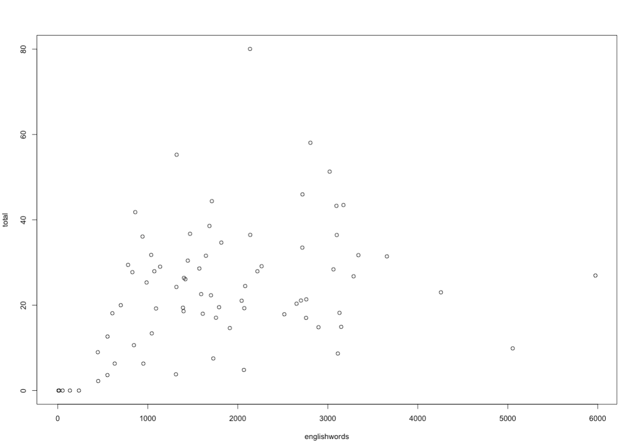
Total Like* Per 1000 Words
Total English Words

Slide 4
SR Other Read, Speak, Write, Understand
Speak and Understand
p>.05
Read
p=0.008, r= -0.307
Write
p=0.0014, r= -0.367
Notes:
cor.test(total, otherread)
plot(total, otherread)
#p = 0.0081
#r = -0.307
cor.test(total, otherwrite)
#p = 0.0014
#r = -0.367

Slide 5
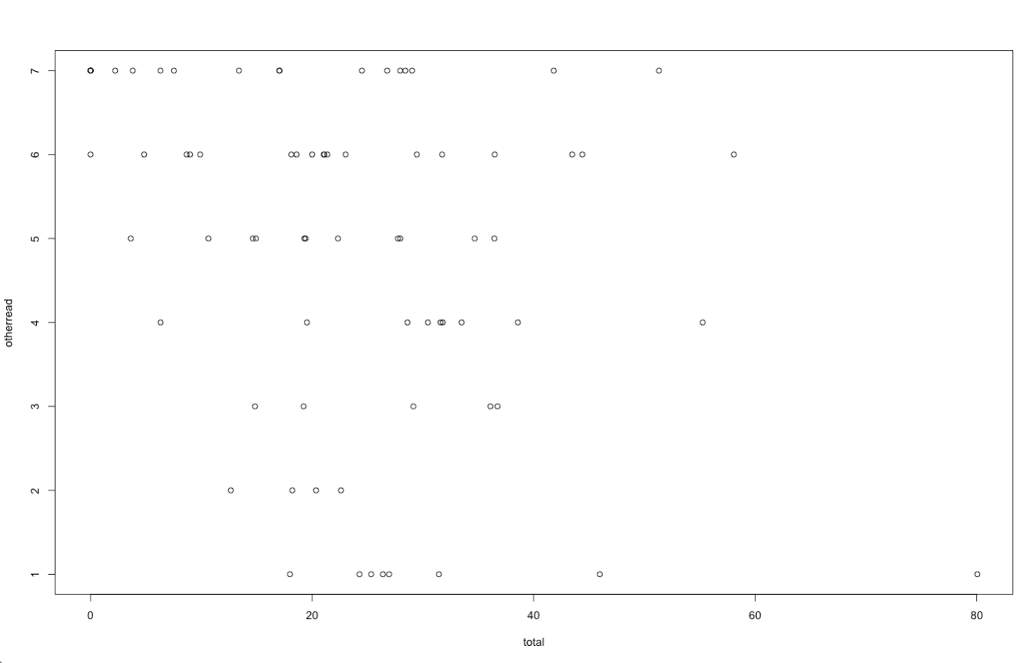
SR Reading Proficiency
Total English Words

Slide 6
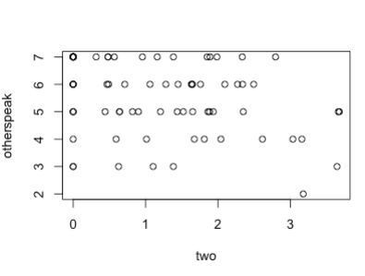
SR Other Speak
Quotative, DM, DP
p>.05
Approximative
p=0.01, r= -0.297
Notes:
### Other Speak
cor.test(one, otherspeak)
cor.test(two, otherspeak)
#p = 0.01
#r = -0.297
cor.test(three, otherspeak)
cor.test(four, otherspeak)

Slide 7
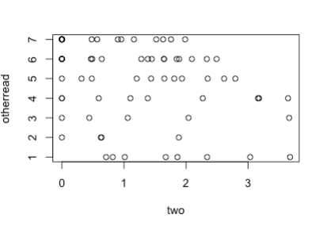
SR Other Read
Like #1
p>.05
Like #2
p=0.006, r= -0.315
Like #3
p=0.012, r= -0.291
Like #4
p=0.013, r= -0.289
Notes:
### Other Read
cor.test(one, otherread)
cor.test(two, otherread)
#p = 0.006
#r = -0.315
cor.test(three, otherread)
#p = 0.012
#r = -0.291
cor.test(four, otherread)
#p = 0.013
#r = -0.289

Slide 8
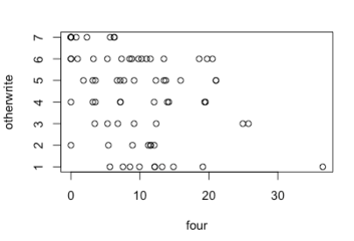
SR Other Write
Like #1
p>.05
Like #2
p=0.002, r= -0.349
Like #3
p=0.004, r= -0.326
Like #4
p=0.002, r= -0.345
Notes:
### Other Write
cor.test(one, otherwrite)
cor.test(two, otherwrite)
#p = 0.002
#r = -0.349
cor.test(three, otherwrite)
#p = 0.004
#r = -0.326
cor.test(four, otherwrite)
#p = 0.002
#r = -0.345

Slide 9
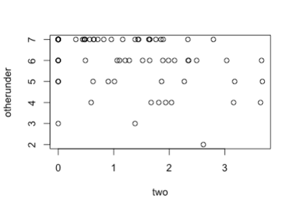
SR Other Understand
Like #1, #3, #4
p>.05
Like #2
p=0.004, r= -0.329
Notes:
### Other Understand
cor.test(one, otherunder)
cor.test(two, otherunder)
#p = 0.004
#r = -0.329
cor.test(three, otherunder)
cor.test(four, otherunder)

Slide 10
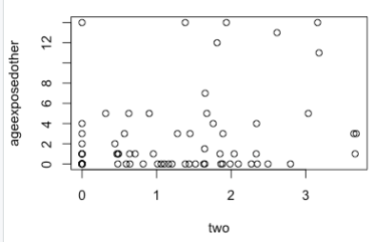
Age Exposed to English and Other
Total Like* per 1000 Words (both English and Other)
p>.05
Like #2 and English
p=0.010, r= -0.294
Like #2 and Other
p=0.012, r= 0.288
Notes:
cor.test(two, ageexposedeng)
#p = 0.010
#r = -0.294
cor.test(two, ageexposedother)
#p = 0.012
#r = 0.288

Slide 11
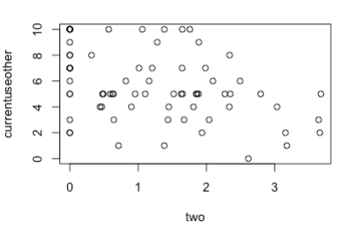
Current Use of Other
Total Like, Like #1, #3, #4
p>.05
Like #2
p=0.0004, r= -0.398
Notes:
cor.test(one, currentuseother)
cor.test(two, currentuseother)
plot(two, currentuseother)
#p = 0.0004
#r = -0.398
cor.test(three, currentuseother)
cor.test(four, currentuseother)

Slide 12
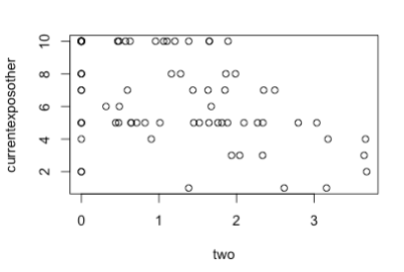
Current Exposure of Other
Total Like, Like #1, #3, #4
p>.05
Like #2
p<.0001, r= -0.441
Notes:
cor.test(total, currentexposother)
cor.test(total, currentuseother)
cor.test(one, currentexposother)
cor.test(two, currentexposother)
plot(two, currentexposother)
#p < .0001
#r = -0.441
cor.test(three, currentexposother)
cor.test(four, currentexposother)

Slide 13
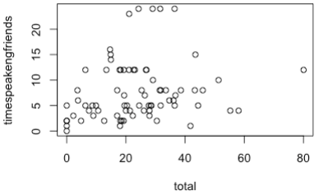
SR Time Speaking English to Friends
Like #1, #3, #4
p>.05
Total Like
p=0.07, r=0.207
Like #2
p=.01, r=0.293
Notes:
cor.test(total, timespeakengfriends)
#p = 0.07
cor.test(one, timespeakengfriends)
cor.test(two, timespeakengfriends)
#p = 0.01
#r = 0.293
cor.test(three, timespeakengfriends)
cor.test(four, timespeakengfriends)

Slide 14
SR Time Speaking Other to Friends
Total Like
p=0.0004, r= -0.400
Like #1
p=0.005, r= -0.317
Like #2
p=0.001, r= -0.366
Like #3
p=0.004, r= -0.325
Like #4
p=0.003, r= -0.336
Notes:
cor.test(total, timespeakotherfriends)
#p = 0.0004
#r = -0.400
cor.test(one, timespeakotherfriends)
#p = 0.005
#r = -0.317
cor.test(two, timespeakotherfriends)
#p = 0.001
#r = -0.366
cor.test(three, timespeakotherfriends)
#p = 0.004
#r = -0.325
cor.test(four, timespeakotherfriends)
#p = 0.003
#r = -0.336

Slide 15
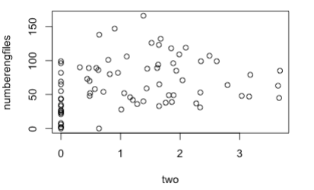
Number of English Only Files
Like #1, #3, #4
p>.05
Total Like
p=0.0549, r=0.22
Like #2
p=0.019, r=0.267
Notes:
cor.test(total, numberengfiles)
#p = 0.0549
#r = 0.22
cor.test(one, numberengfiles)
cor.test(two, numberengfiles)
plot(two, numberengfiles)
#p = 0.019
cor.test(three, numberengfiles)
cor.test(four, numberengfiles)

Slide 16
SR Codeswitching
Like #2 and CS #2 (Situations)
p=0.016, r= -0.274
Like #2 and CS #3 (Topics)
p=0.015, r= -0.276
Notes:
cor.test(two, cs2) Situations
#p = 0.016
#r = -0.274
cor.test(two, cs3) Topics
#p = 0.015
#r = -0.276

